Slide 1
PRESENTED BY – MOHIT SHARMA (88200)
Subject: Major Project
Topic: “CurrencyX: A Robust Currency Converter Application Using React”
SUBMITTED TO – MS. NENY PANDEL , ASSISTANT
PROFESSOR (CEIT DEPT)

Slide 2
Contents
Introduction
Literature Review
Methodology
Technologies and Tools
Data Sources and Collection
Design and Architecture
Development Process
Code Snippets and Screenshots
Testing Methods
Test Results and Implications
Comparison with Existing Solutions
Conclusion

Slide 3
Introduction
Brief Overview of the Project: The "Currency Converter" project is an innovative digital solution designed to simplify and enhance currency conversion processes. It offers a user-friendly interface and real-time exchange rate data, making it a valuable tool for individuals, travelers, and businesses.
Importance and Relevance: In today's interconnected world, currency conversion is a crucial aspect of international trade, travel, and financial management. The project addresses the growing need for accurate, reliable, and user-centric currency conversion tools.
Objectives and Scope: The primary objective of this project is to develop a currency conversion application using React. The scope encompasses the creation of a user-friendly interface, integration with real-time data sources, and an emphasis on data accuracy.
Significance and Motivation: Currency conversion is a fundamental requirement for various individuals and industries, including travelers, investors, and businesses engaged in global commerce. The significance of this project lies in its potential to provide a reliable and efficient solution for users, simplifying their currency conversion tasks.

Slide 4
Literature Review
The literature review section provides an overview of relevant research and academic works in the field of currency conversion. It encompasses studies, articles, and publications that contribute to the understanding of currency exchange rate dynamics, the importance of real-time data, and the challenges faced by users.
In this section, we explore and evaluate existing currency converter applications available in the market. We analyze their features, user interfaces, data sources, and limitations. The aim is to identify gaps and opportunities for improvement in the current landscape of currency conversion tools.
The literature review also delves into the theoretical foundations and concepts that underpin the currency exchange domain. It includes discussions on foreign exchange markets, exchange rate determinants, and the principles that govern currency conversion processes. Understanding these concepts is essential for building an effective currency conversion application.

Slide 5
Methodology
The methodology used for this project involves a structured and systematic development approach. It encompasses the selection of development tools, programming languages, and frameworks. The choice of React as the core technology ensures a robust and responsive user interface.
The project unfolds through a series of well-defined phases. These include project initiation, planning, development, testing, and deployment. Each phase plays a crucial role in the overall success of the project. The methodology ensures that the development process remains organized, efficient, and responsive to changing requirements.

Slide 6
Technologies And Tools
This project leverages a set of modern and powerful technologies. React, a popular JavaScript library, serves as the foundation of the application, providing a responsive and user-friendly interface. Real-time exchange rate data is obtained through a reputable API, ensuring data accuracy. The use of modern web development technologies and frameworks ensures a robust and reliable application.
The development process is facilitated by a range of essential tools and software. These include code editors, version control systems, and testing frameworks. They contribute to the efficiency and quality of the project.

Slide 7
Data Sources and Collection
The project relies on real-time exchange rate data to provide accurate and up-to-date currency conversion results. This data is sourced from a reputable Exchange Rate API, ensuring the reliability of conversion rates.
Methods Used for Data Collection:
API Integration: The primary method of data collection involves integrating with the Exchange Rate API. This API provides real-time exchange rate data for a wide range of currencies.
Data Synchronization: The application periodically synchronizes with the API to fetch the latest exchange rate data. This ensures that users always have access to current conversion rates.
Error Handling: Robust error handling mechanisms are in place to address data retrieval issues, ensuring a seamless user experience.

Slide 8
Design and Architecture
Overview of the Application's Design Principles: The design of the "React Currency Converter App" is centered on user-friendliness and simplicity. It offers an intuitive and visually appealing interface that caters to a wide audience. User input is streamlined, making currency conversion tasks effortless.
Description of the Application's Architecture: The application is built on a component-based architecture. Each component within the application is responsible for specific functions, promoting modularity and ease of maintenance. This architecture enhances code management and supports the integration of new features and improvements.

Slide 9
Development Process
The development of the "React Currency Converter App" unfolded through a series of well-defined stages. These stages included project initiation, planning, design, coding, testing, and deployment. Each stage played a vital role in shaping the application and ensuring its quality.
Highlight Key Milestones and Achievements:
Milestone 1 - Project Initiation: Project kickoff, defining project goals, and selecting development tools.
Milestone 2 - Design and Planning: Creation of wireframes and user interface design, outlining the project plan.
Milestone 3 - Development: Implementation of the application's core features, including real-time data integration.
Milestone 4 - Testing: Rigorous testing and quality assurance, ensuring data accuracy and a seamless user experience.
Milestone 5 - Deployment: Successful deployment of the application to a production environment, making it available to users.

Slide 10
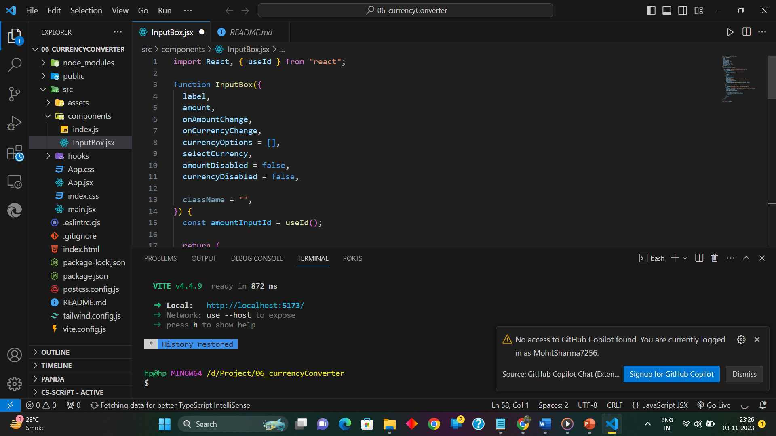
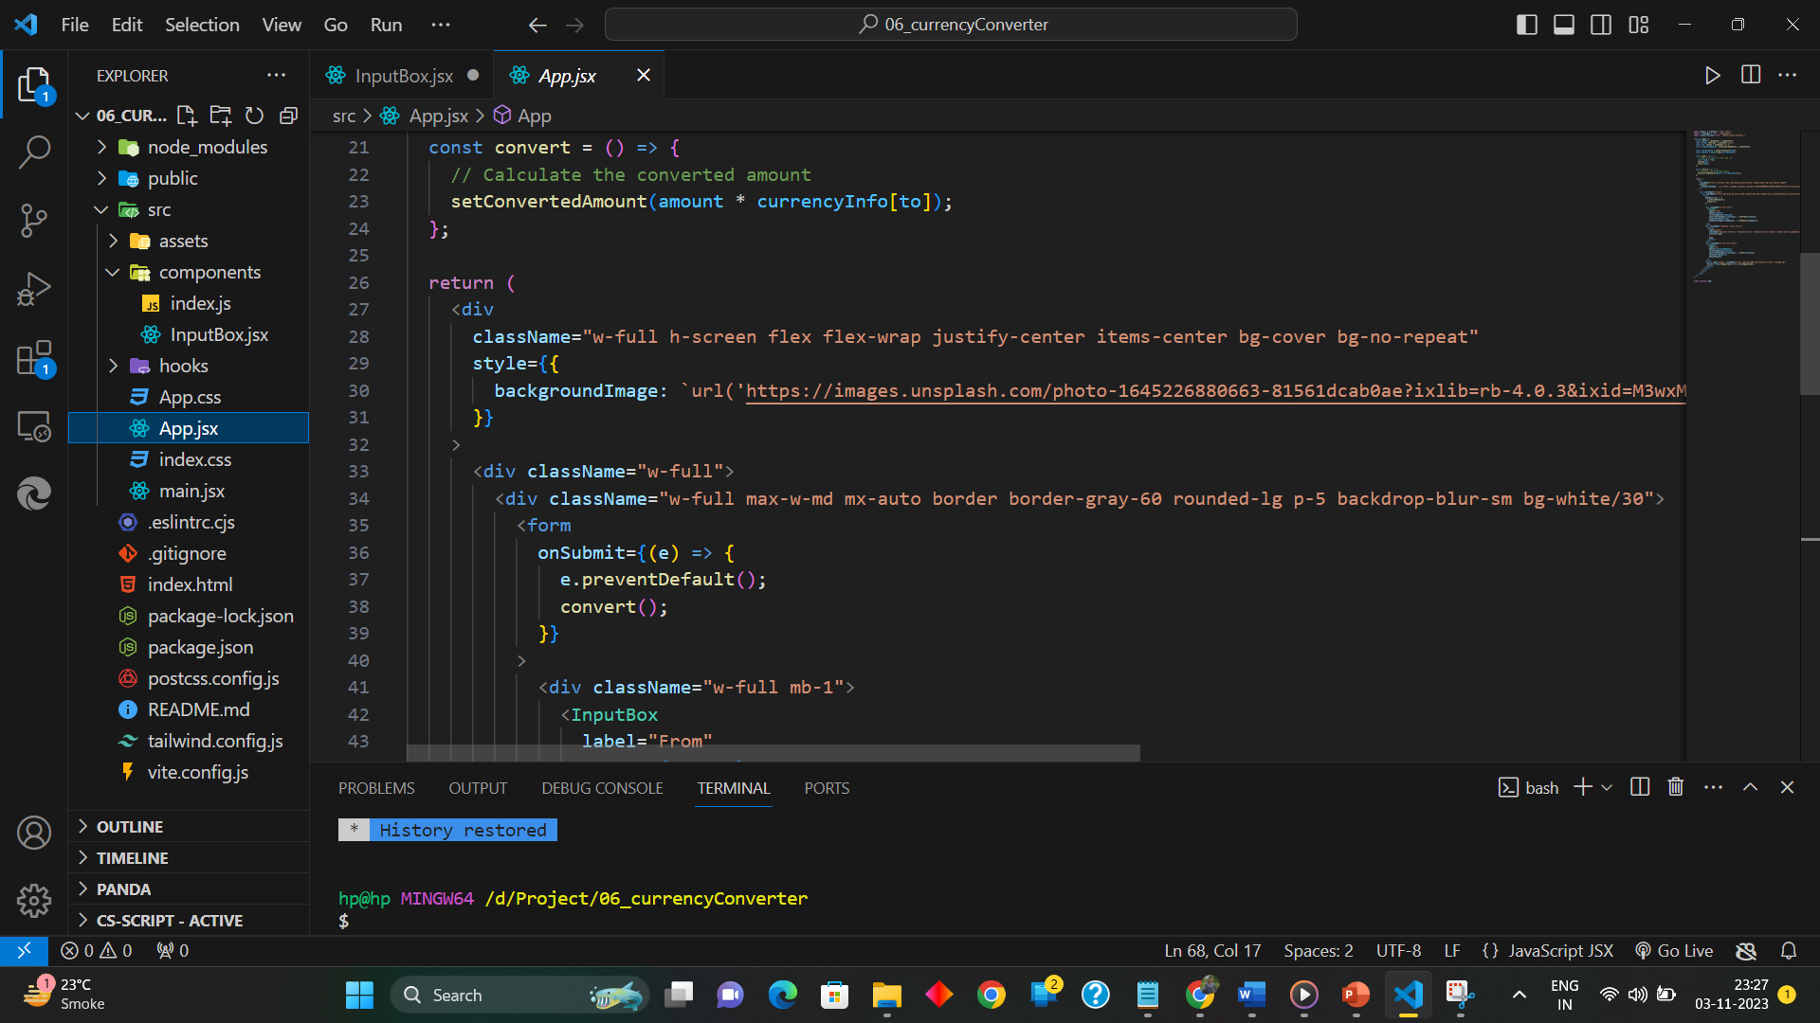
Code Snippets and Screenshots

Slide 11
Testing Methods
Testing is a critical phase in the development process. This section provides an overview of the testing methods employed to ensure the quality and reliability of the "React Currency Converter App." It includes unit testing, integration testing, end-to-end testing, and performance testing. Each method serves a specific purpose in evaluating the application's functionality, security, and performance.
Overview of the Testing Phases: Testing in the project is organized into distinct phases. These phases include:
Unit Testing: Evaluating individual components and functions to ensure they work as intended.
Integration Testing: Assessing the interaction between different parts of the application to identify and rectify any integration issues.
End-to-End (E2E) Testing: Validating the entire application from the user's perspective, ensuring that all features work harmoniously.
Performance Testing: Measuring the application's response times, resource utilization, and scalability to guarantee it can handle various loads.

Slide 12
Testing Methods
The testing phase provided valuable insights into the "React Currency Converter App." A summary of the testing results, including outcomes from unit testing, integration testing, end-to-end testing, and performance testing, will be presented. This summary will cover both the successes and challenges encountered during testing.
Implications for the Application's Quality:
Enhanced Reliability: Successful testing ensures that the application operates reliably and accurately.
User Satisfaction: The positive testing results contribute to an improved user experience, making the application user-friendly.
Data Accuracy: Testing verifies that real-time data synchronization delivers accurate conversion rates.
Robust Performance: The application's performance testing indicates its capacity to handle diverse user loads effectively.

Slide 13
Conclusion
Summary of Key Findings and Contributions: The project has yielded several key findings and made significant contributions to the field of currency conversion. These findings and contributions may include enhanced user experiences, accurate data sourcing, and the use of modern technologies.
Implications of the Project: The project's successful completion has wide-reaching implications. It provides users with a reliable and user-friendly tool for currency conversion. Moreover, it contributes to the broader discussion of efficient financial tools and applications.
Future Work and Recommendations: As we conclude, it's essential to consider the path forward. This section includes recommendations for future work, such as expanding the application's features, improving data sources, and enhancing security measures. It also invites suggestions for further enhancements and innovations in currency conversion solutions.

Slide 14
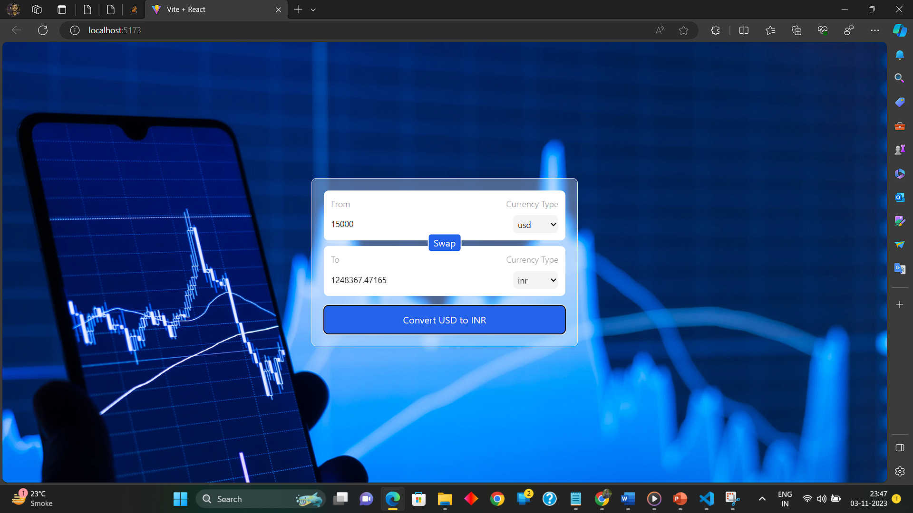
Screenshots -

Slide 15
“Payroll Management System” software developed for a company has been designed to achieve maximum efficiency and reduce the time taken to handle the Payroll activity.
It is designed to replace an existing manual record system thereby reducing time taken for calculations and for storing data. The system uses Asp .NET as front end and Microsoft SQL as a backend for the database.
The system is strong enough to withstand regressive daily operations under conditions where the database is maintained and cleared over a certain time of span. The implementation of the system in the organization will considerably reduce data entry, time and also provide readily calculated reports

Slide 16


